Slide 1

Summer School

Slide 2

Business Analytics and Data Science
INTRODUCTION

Slide 3

Know your Instructor
Author "R for Business Analytics"
Author “ R for Cloud Computing”
Founder "Decisionstats.com"
University of Tennessee, Knoxville MS (courses in statistics and computer science)
MBA (IIM Lucknow,India-2003)
B.Engineering (DCE 2001)
http://linkedin.com/in/ajayohri

Slide 4

Classroom Rules
From Instructor
From Audience
mobile phones should be kindly switched off
Yes, this includes Whatsapp
Ask Questions at end of session
Take Notes
Please Take Notes

Slide 5

Introduce yourself
Name
Education Degree from Institute
Work Ex in Years in Domain

Slide 6

Introduce yourself
Name
Education Degree from Institute
Work Ex in Years in Domain
What expectations from this training

Slide 7

Expectations
How Data Science can help your career ?

Slide 8
Support Team
Madhuresh

Slide 9
Introduction to Data Science
Basics of Data Science
Basics of Analytics
LTV Analysis
LTV Analysis Quiz
RFM Analysis
RFM Analysis Quiz
Basic Stats
Introduction to Modeling
Introduction to Google Analytics
Blogging
Web Analytics Quiz

Slide 10
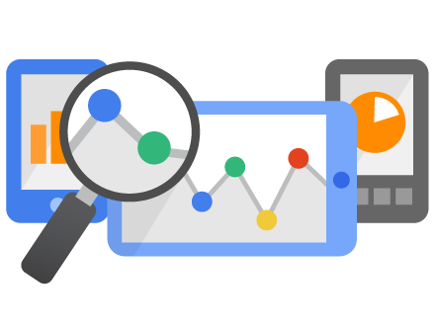
Introduction to Data Science

Slide 11
Information Ladder
The information ladder was created by education professor Norman Longworth to describe the stages in human learning. According to the ladder, a learner moves through the following progression to construct “wisdom”from “data”
Data →
Information →
Knowledge →
Understanding →
Insight →
Wisdom

Slide 12
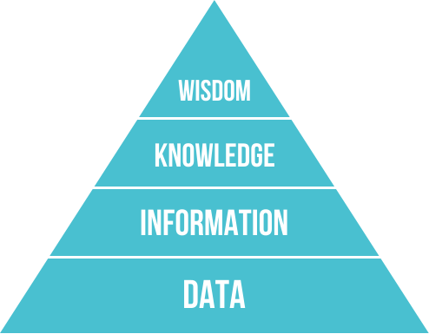
DIKW

Slide 13
Basics of Data Science
http://en.wikipedia.org/wiki/Data_science
Data Science is the extraction of knowledge from data,^{[1][2]} which is a continuation of the field data miningand predictive analytics, also known as knowledge discovery and data mining (KDD). It employs techniques and theories drawn from many fields within the broad areas of mathematics, statistics, information theory and information technology, including signal processing, probability models, machine learning, statistical learning, data mining, database, data engineering, pattern recognition and learning, visualization, predictive analytics, uncertainty modeling, data warehousing,data compression, computer programming, and high performance computing. Methods that scale to Big Data are of particular interest in data science, although the discipline is not generally considered to be restricted to such data. The development ofmachine learning, a branch of artificial intelligence used to uncover patterns in data from which predictive models can be developed, has enhanced the growth and importance of data science.
CONFUSING?

Slide 14
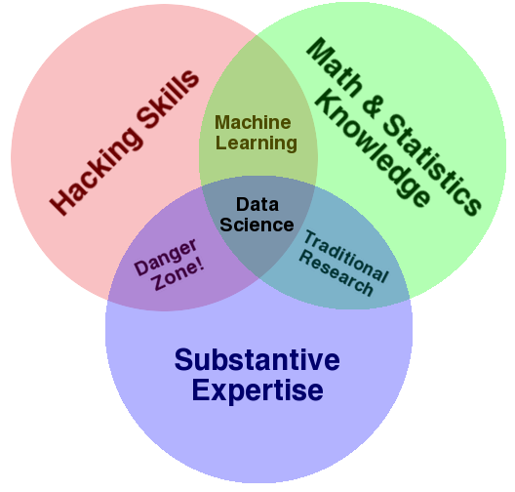
Basics of Data Science
http://drewconway.com/zia/2013/3/26/the-data-science-venn-diagram
the culture of academia, which does not reward researchers for understanding technology.
DANGER ZONE- this overlap of skills gives people the ability to create what appears to be
a legitimate analysis without any understanding of how they got there or
what they have created
Being able to manipulate text files at the command-line,
understanding vectorized operations, thinking algorithmically;
these are the hacking skills that make for a successful data hacker.
data plus math and statistics only gets you machine learning,
which is great if that is what you are interested in, but not if you are doing data science

Slide 15
Business Intelligence
Business intelligence (BI) is an umbrella term that includes the applications, infrastructure and tools, and best practices that enable access to and analysis of information to improve and optimize decisions and performance.
The key general categories of business intelligence tools are:
Spreadsheets
Reporting and querying software: tools that extract, sort, summarize, and present selected data
OLAP: Online analytical processing
Digital dashboards
Data mining
Data warehousing
Local information systems

Slide 16
What is Business Analytics
Definition – study of business data using statistical techniques and programming for creating decision support and insights for achieving business goals
Predictive- To predict the future.
Descriptive- To describe the past.

Slide 17
So what is a Data Scientist ?
a data scientist is simply a data analyst living in california

Slide 18
What is a Data Scientist
a data scientist is simply a person who can
write code
understand statistics
derive insights from data

Slide 19
Oh really, is this a Data Scientist ?
a data scientist is simply a person who can
write code = in R,Python,Java, SQL, Hadoop (Pig,HQL,MR) etc
= for data storage, querying, summarization, visualization
= how efficiently, and in time (fast results?)
= where on databases, on cloud, servers
and understand enough statistics
to derive insights from data
so business can make decisions

Slide 20
Guide for Data Scientists
http://www.kdnuggets.com/2014/05/guide-to-data-science-cheat-sheets.html
By Ajay Ohri, May 2014.
Over the past few years, as the buzz and apparently the demand for data scientists has continued to grow, people are eager to learn how to join, learn, advance and thrive in this seemingly lucrative profession. As someone who writes on analytics and occasionally teaches it, I am often asked - How do I become a data scientist?
Adding to the complexity of my answer is data science seems to be a multi-disciplinary field, while the university departments of statistics, computer science and management deal with data quite differently.
But to cut the marketing created jargon aside, a data scientist is simply a person who can write code in a few languages (primarily R, Python and SQL) for data querying, manipulation , aggregation, and visualization using enough statistical knowledge to give back actionable insights to the business for making decisions.
http://www.slideshare.net/ajayohri/cheat-sheets-for-data-scientists

Slide 21
So once again
Business Analytics
Understanding what solution business needs
Data Science
Primarily R programming skills
Some Applied Statistical Methods
Exposure to new domains and techniques

Slide 22
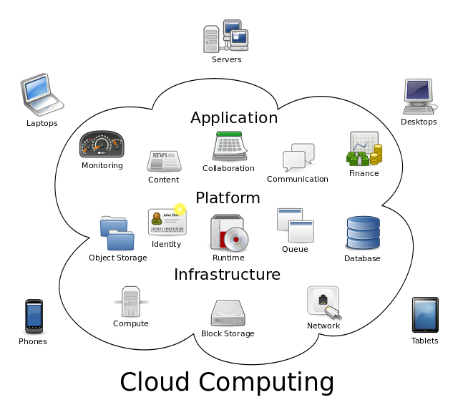
Cloud Computing
the practice of using a network of remote servers hosted on the Internet to store, manage, and process data, rather than a local server or a personal computer.
http://csrc.nist.gov/publications/nistpubs/800-145/SP800-145.pdf

Slide 23
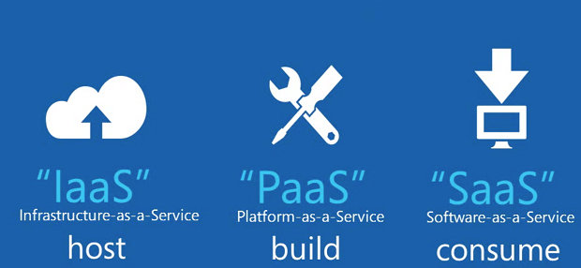
Cloud Computing
the practice of using a network of remote servers hosted on the Internet to store, manage, and process data, rather than a local server or a personal computer.
http://csrc.nist.gov/publications/nistpubs/800-145/SP800-145.pdf

Slide 24
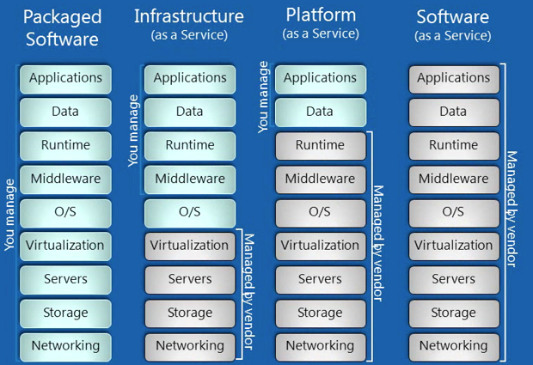
Cloud Computing

Slide 25
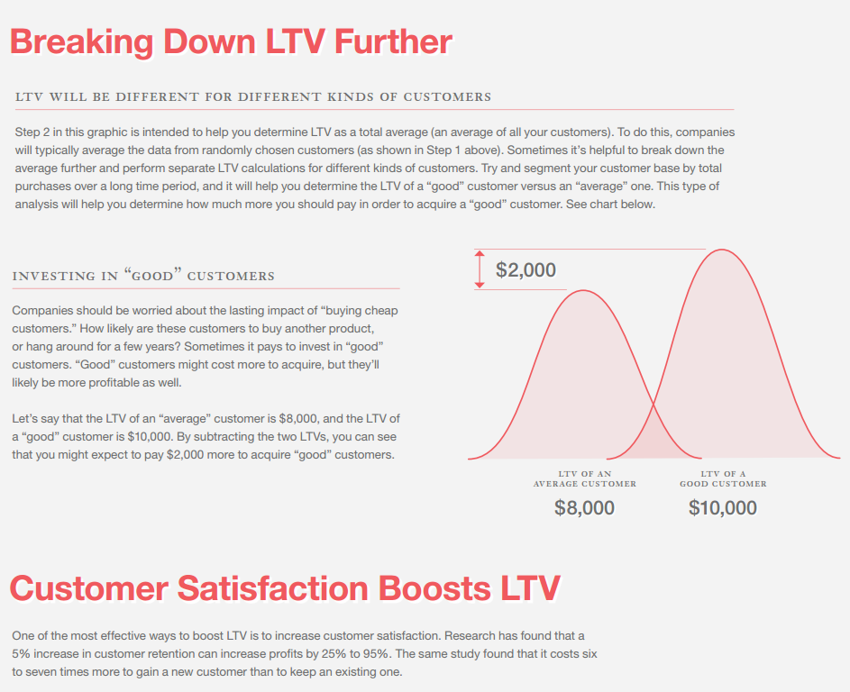
LTV Analytics
Life Time Value (LTV) will help us answer 3 fundamental questions:
1. Did you pay enough to acquire customers from each marketing channel?
2. Did you acquire the best kind of customers?
3. How much could you spend on keeping them sweet with email and social media?

Slide 26
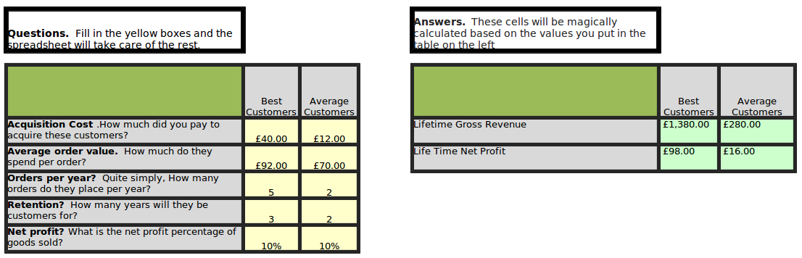
LTV Analytics
http://www.kaushik.net/avinash/analytics-tip-calculate-ltv-customer-lifetime-value/

Slide 27
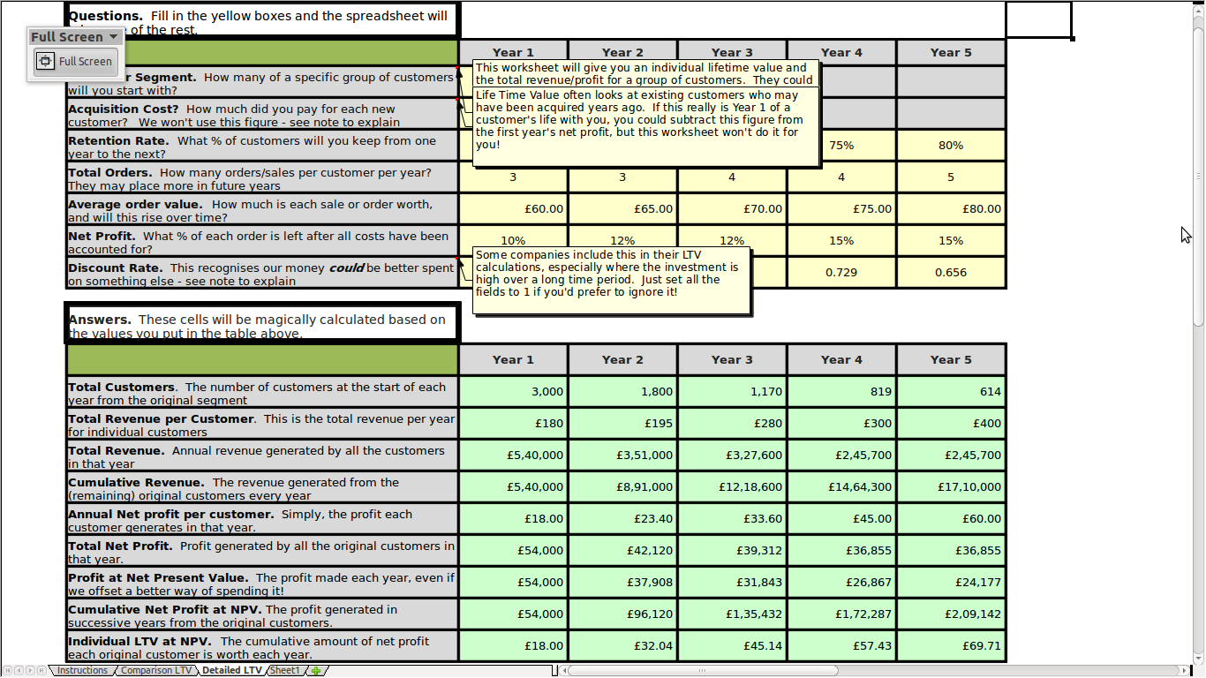
LTV Analytics
http://www.kaushik.net/avinash/analytics-tip-calculate-ltv-customer-lifetime-value/

Slide 28
LTV Analytics
Download the zip file from http://www.kaushik.net/avinash/avinash_ltv.zip
Do the class exercise based on numbers given by instructor
Give a brief supporting statement on analysis

Slide 29
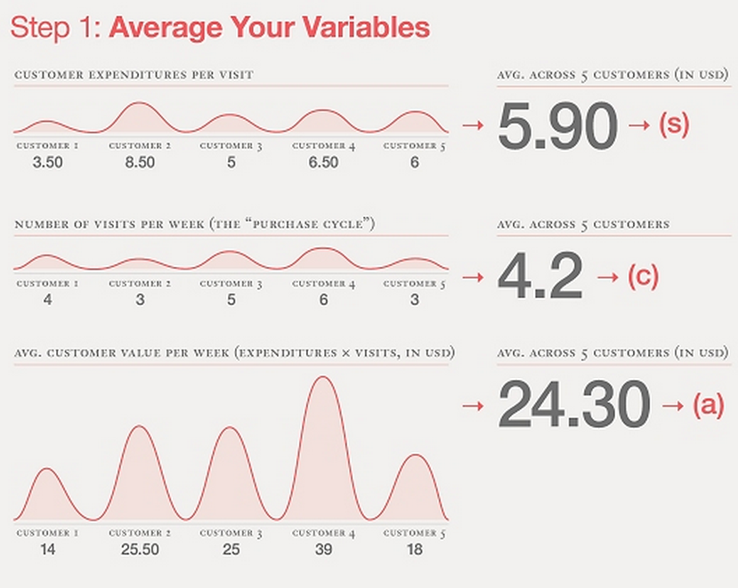
LTV Analytics :Another Approach
https://blog.kissmetrics.com/how-to-calculate-lifetime-value/

Slide 30
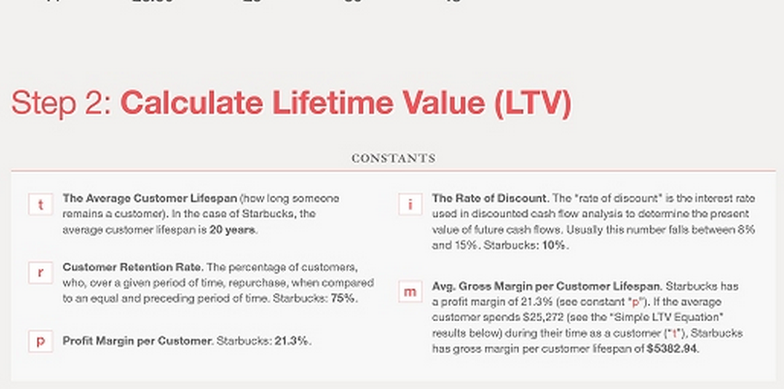
LTV Analytics
https://blog.kissmetrics.com/how-to-calculate-lifetime-value/

Slide 31
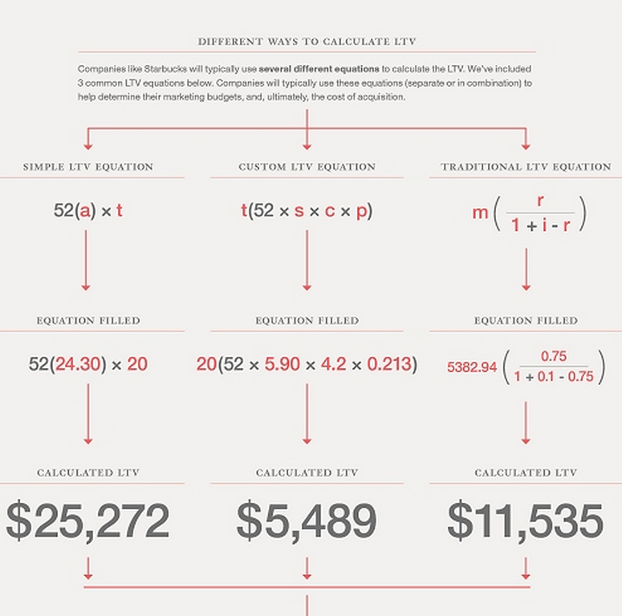
LTV Analytics
https://blog.kissmetrics.com/how-to-calculate-lifetime-value/

Slide 32
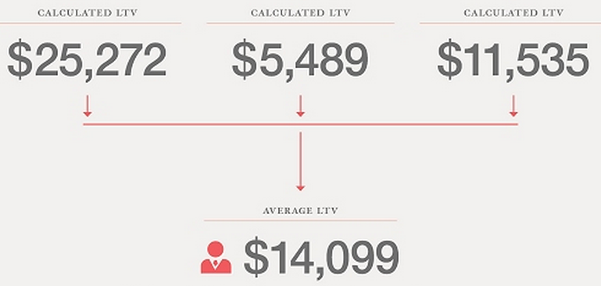
LTV Analytics
https://blog.kissmetrics.com/how-to-calculate-lifetime-value/

Slide 33
Pareto principle
The Pareto principle (also known as the 80–20 rule, the law of the vital few, and the principle of factor sparsity) states that, for many events, roughly 80% of the effects come from 20% of the causes
80% of a company's profits come from 20% of its customers
80% of a company's complaints come from 20% of its customers
80% of a company's profits come from 20% of the time its staff spend
80% of a company's sales come from 20% of its products
80% of a company's sales are made by 20% of its sales staff
Several criminology studies have found 80% of crimes are committed by 20% of criminals.

Slide 34
RFM Analysis
RFM is a method used for analyzing customer value.
Recency - How recently did the customer purchase?
Frequency - How often do they purchase?
Monetary Value - How much do they spend?

Slide 35
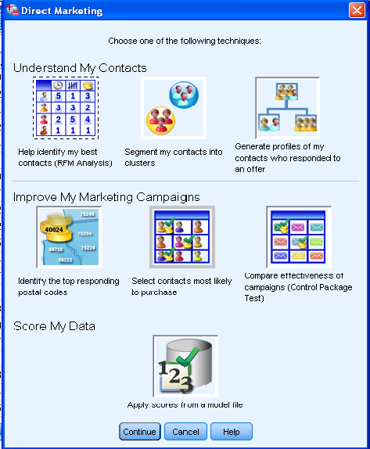
RFM Analysis
Using SPSS 19 - example

Slide 36
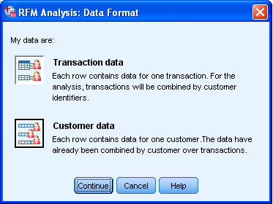
RFM Analysis
Using SPSS 19 - example

Slide 37
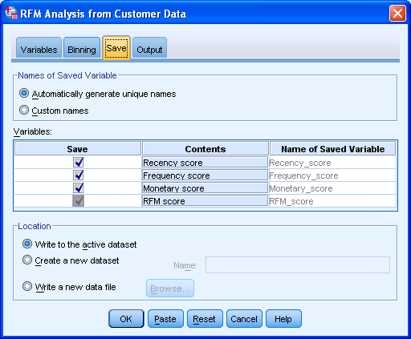
RFM Analysis
Using SPSS 19 - example

Slide 38
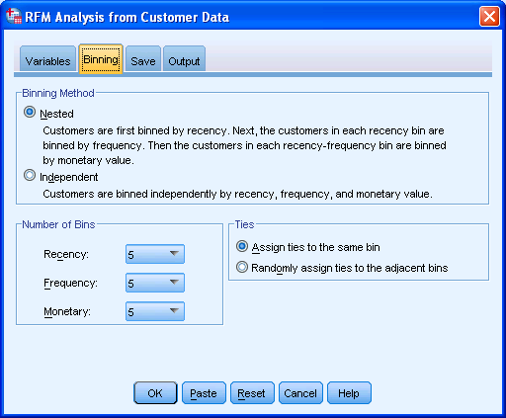
RFM Analysis
Using SPSS 19 - example

Slide 39
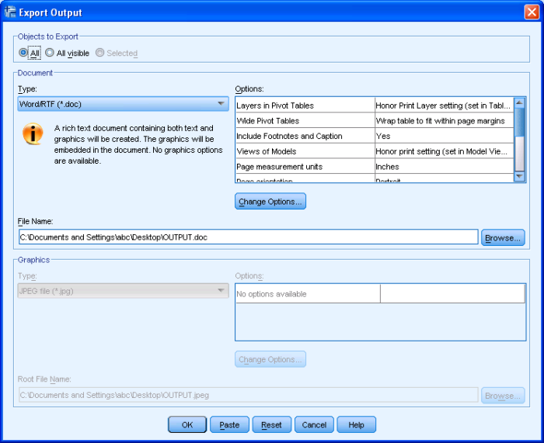
RFM Analysis
Using SPSS 19 - example

Slide 40
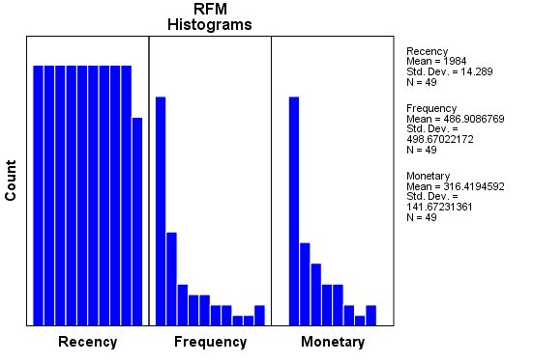
RFM Analysis
Using SPSS 19 - example

Slide 41
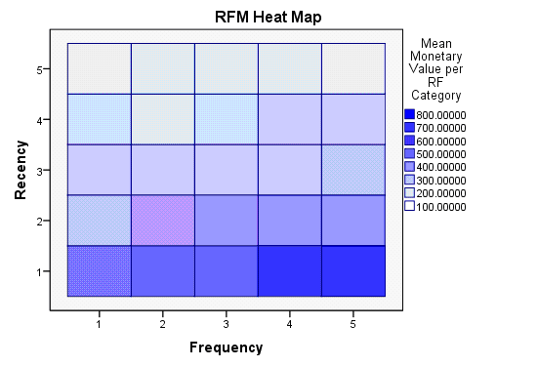
RFM Analysis
Using SPSS 19 - example

Slide 42
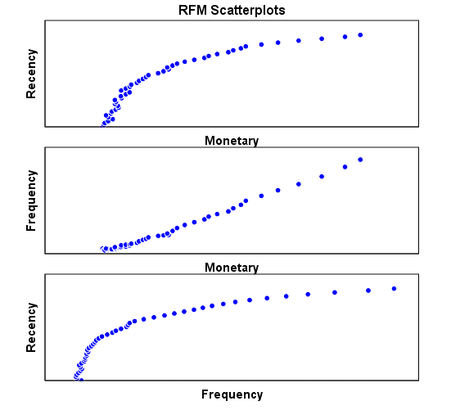
RFM Analysis
Using SPSS 19 - example

Slide 43
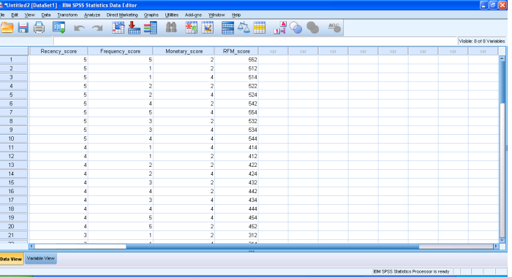
RFM Analysis
Using SPSS 19 - example

Slide 44
RFM Analysis
RFM is a method used for analyzing customer value.
Recency - How recently did the customer purchase?
Frequency - How often do they purchase?
Monetary Value - How much do they spend?
A method
Recency = 10 - the number of months that have passed since the customer last purchased
Frequency = number of purchases in the last 12 months (maximum of 10)
Monetary = value of the highest order from a given customer (benchmarked against $10k)
Alternatively, one can create categories for each attribute. For instance, the Recency attribute might be broken into three categories: customers with purchases within the last 90 days; between 91 and 365 days; and longer than 365 days. Such categories may be arrived at by applying business rules, or using a data mining technique, to find meaningful breaks.
A commonly used shortcut is to use deciles. One is advised to look at distribution of data before choosing breaks.

Slide 45
Refresher in Statistics
Mean
Arithmetic Mean- the sum of the values divided by the number of values.
The geometric mean is an average that is useful for sets of positive numbers that are interpreted according to their product and not their sum (as is the case with the arithmetic mean) e.g. rates of growth.
Median
the median is the number separating the higher half of a data sample, a population, or a probability distribution, from the lower hal
Mode-
The "mode" is the value that occurs most often.

Slide 46
Refresher in Statistics
Range
the range of a set of data is the difference between the largest and smallest values.
Variance
mean of squares of differences of values from mean
Standard Deviation
square root of its variance
Frequency
a frequency distribution is a table that displays the frequency of various outcomes in a sample.

Slide 47


Distributions
Bernoulli
Distribution of a random variable which takes value 1 with success probability and value 0 with failure probability. It can be used, for example, to represent the toss of a coin

Slide 48
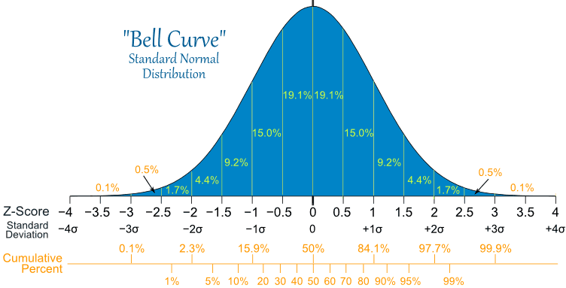
Distributions
Normal
The simplest case of a normal distribution is known as the standard normal distribution. This is a special case where μ=0 and σ=1,

Slide 49
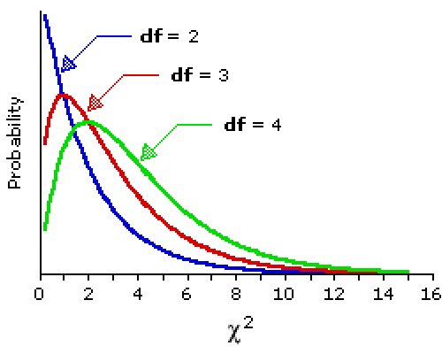
Distributions
Chi Square
the distribution of a sum of the squares of k independent standard normal random variables.

Slide 50
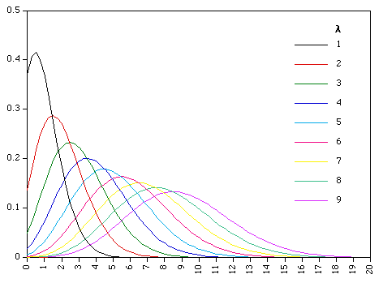
Distributions
Poisson
a discrete probability distribution that expresses the probability of a given number of events occurring in a fixed interval of time and/or space if these events occur with a known average rate and independently of the time since the last event

Slide 51
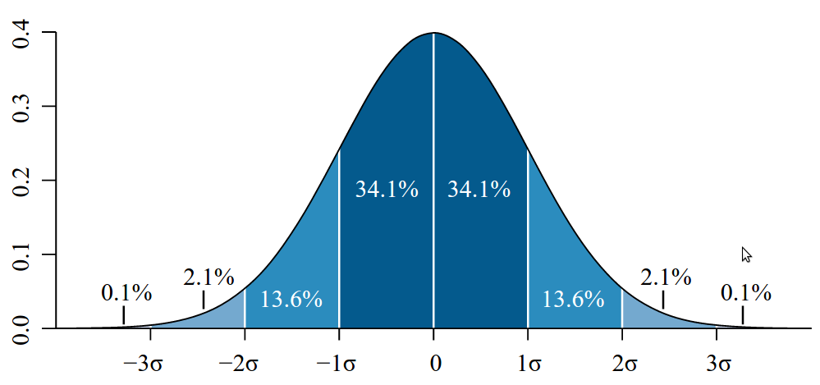
Refresher in Statistics
Probability Distribution
The probability density function (pdf) of the normal distribution, also called Gaussian or "bell curve", the most important continuous random distribution. As notated on the figure, the probabilities of intervals of values correspond to the area under the curve.

Slide 52
Refresher in Statistics
Central Limit Theorem -
In probability theory, the central limit theorem (CLT) states that, given certain conditions, the arithmetic mean of a sufficiently large number of iterates of independentrandom variables, each with a well-defined expected value and well-defined variance, will be approximately normally distributed, regardless of the underlying distribution.

Slide 53
Introduction to Modeling

Slide 54
Hypothesis testing
Hypothesis testing is the use of statistics to determine the probability that a given hypothesis is true. The usual process of hypothesis testing consists of four steps.
1. Formulate the null hypothesis (commonly, that the observations are the result of pure chance) and the alternative hypothesis (commonly, that the observations show a real effect combined with a component of chance variation).
2. Identify a test statistic that can be used to assess the truth of the null hypothesis.
3. Compute the P-value, which is the probability that a test statistic at least as significant as the one observed would be obtained assuming that the null hypothesis were true. The smaller the -value, the stronger the evidence against the null hypothesis.
4. Compare the -value to an acceptable significance value (sometimes called an alpha value). If , that the observed effect is statistically significant, the null hypothesis is ruled out, and the alternative hypothesis is valid.
http://mathworld.wolfram.com/HypothesisTesting.html

Slide 55
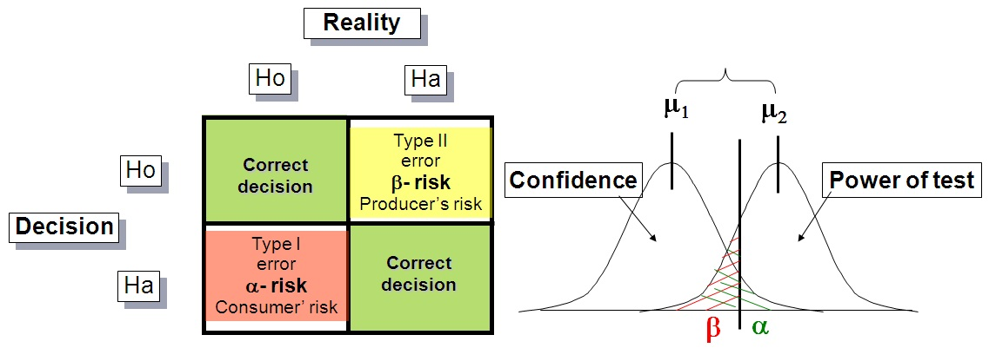
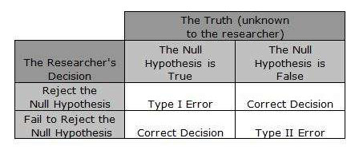
Hypothesis testing

Slide 56
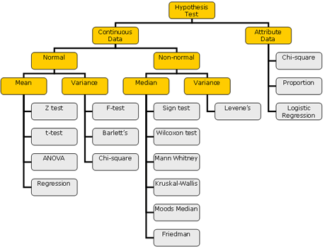
Hypothesis testing

Slide 57
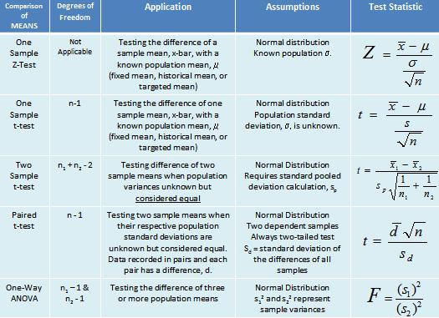
Hypothesis testing

Slide 58
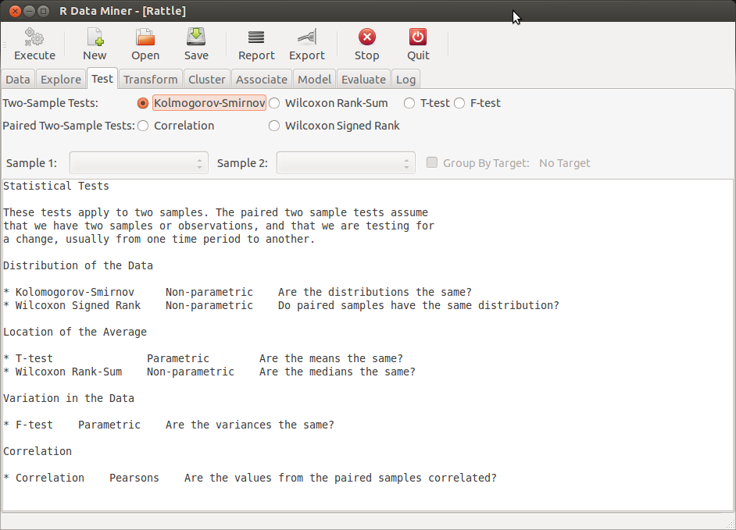
Hypothesis testing

Slide 59
Data Mining
Data Mining is an analytic process designed to explore data (usually large amounts of data - typically business or market related - also known as "big data") in search of consistent patterns and/or systematic relationships between variables, and then to validate the findings by applying the detected patterns

Slide 60
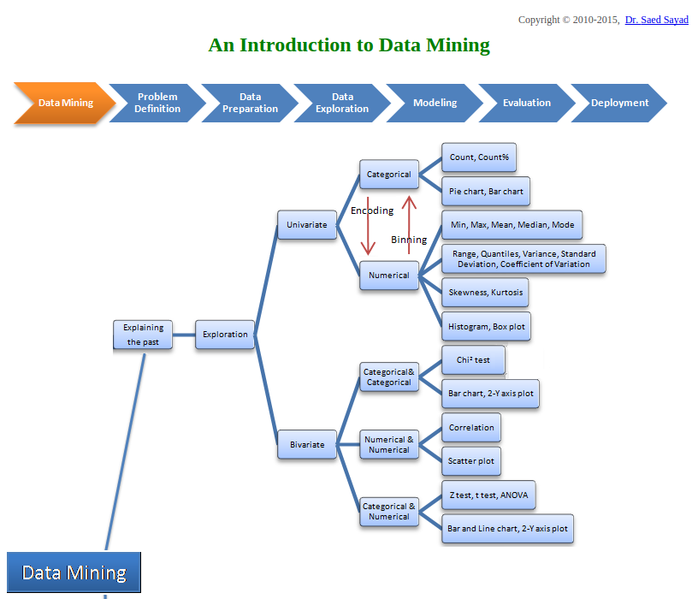
Data Mining Map
Source-
http://www.saedsayad.com/

Slide 61
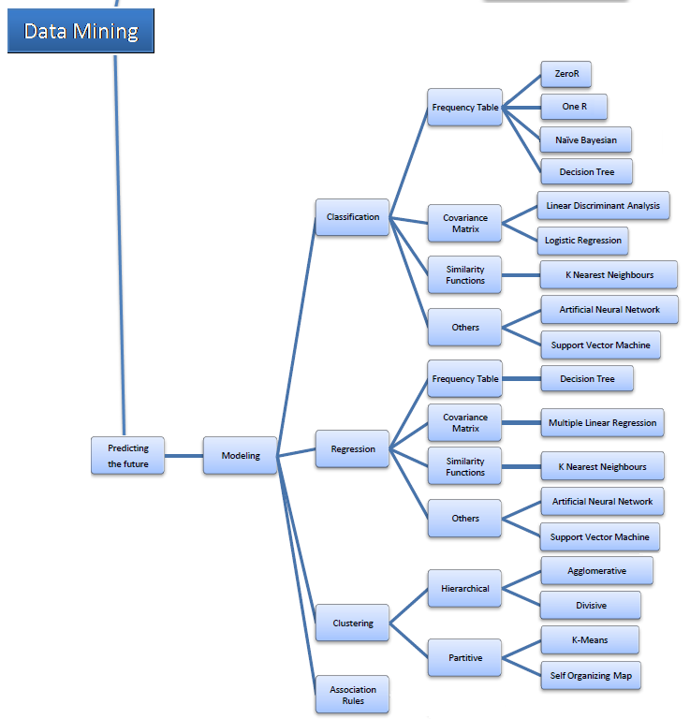
Data Mining Map
Source-
http://www.saedsayad.com/

Slide 62
Examples of Data Mining
which items sell well together in retail ( market basket)
which products sell well together on a website ( association analysis)
which customers are likely to buy a new credit card (regression)

Slide 63
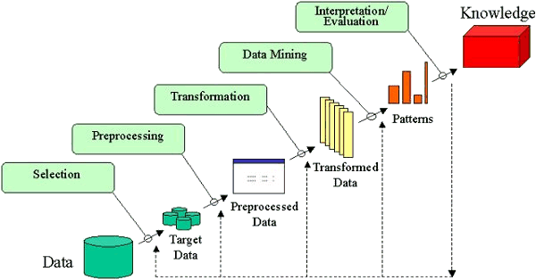
KDD

Slide 64
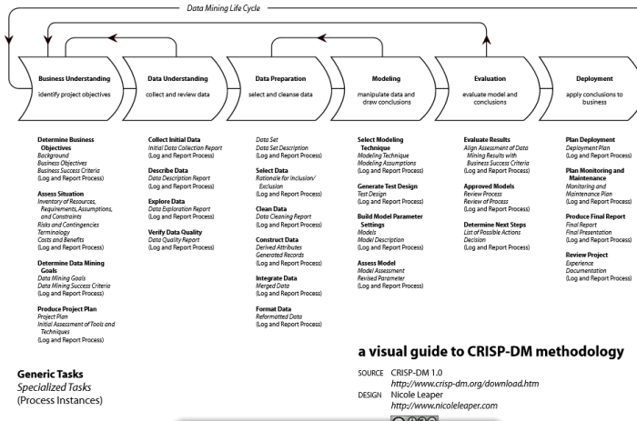
CRISP DM

Slide 65
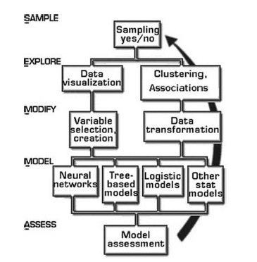
SEMMA

Slide 66
Machine Learning
Machine learning is a subfield of computer science that evolved from the study of pattern recognition and computational learning theory in artificial intelligence.
Machine learning explores the construction and study of algorithms that can learn from and make predictions on data.
Supervised learning. The computer is presented with example inputs and their desired outputs, given by a "teacher", and the goal is to learn a general rule that maps inputs to outputs.
Unsupervised learning, no labels are given to the learning algorithm, leaving it on its own to find structure in its input. Unsupervised learning can be a goal in itself (discovering hidden patterns in data) or a means towards an end.
In classification, a supervised way, inputs are divided into two or more classes, and the learner must produce a model that assigns unseen inputs to one (or multi-label classification) Spam filtering, where the inputs are email (or other) messages and the classes are "spam" and "not spam".
In regression, also a supervised problem, the outputs are continuous rather than discrete.
In clustering, a set of inputs is to be divided into groups. Unlike in classification, the groups are not known beforehand, making this typically an unsupervised task.

Slide 67
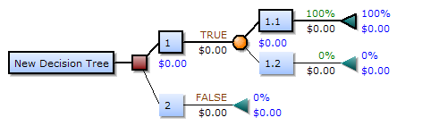
Decision Trees

Slide 68
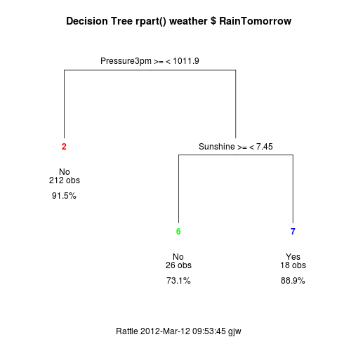
Decision Trees

Slide 69
Association Analysis
As an unsupervised learning technique it has delivered considerable benefit in areas ranging from the traditional shopping basket analysis to the analysis of who bought what other books or who watched what other videos, and in areas including health care, telecommunications, and so on
from
http://handsondatascience.com/ARulesO.pdf

Slide 70
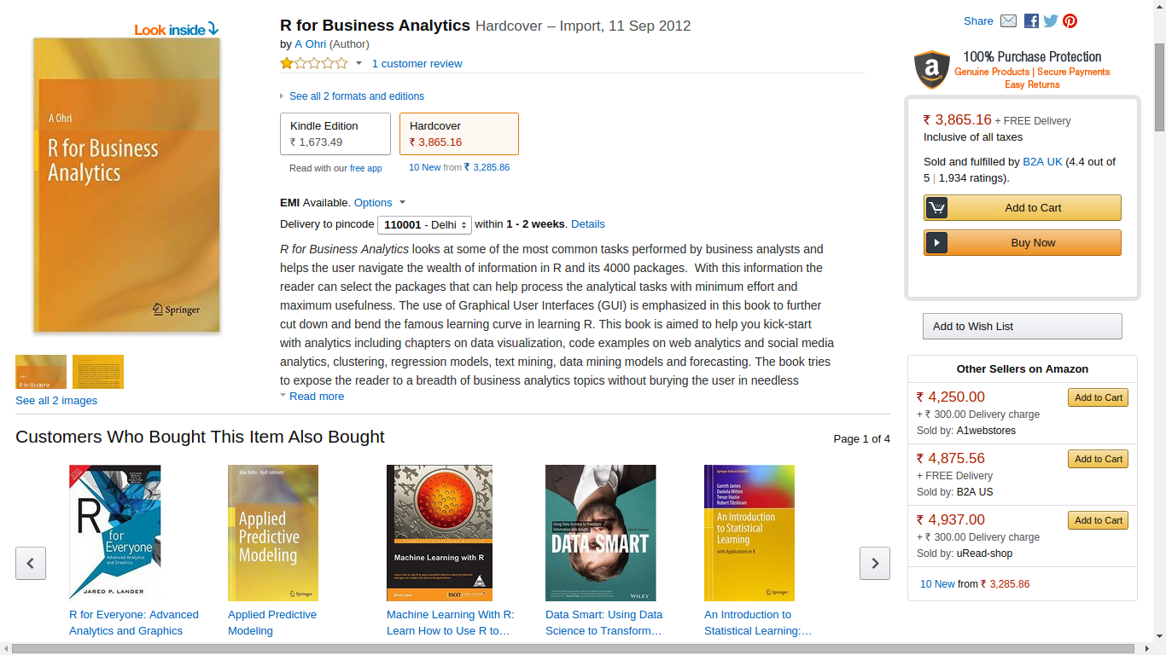
An example of Data Mining

Slide 71
An example of Data Mining
Examples
https://en.wikipedia.org/wiki/Apriori_algorithm
transaction ID | milk | bread | butter | beer | diapers
1 | 1 | 1 | 0 | 0 | 0
2 | 0 | 0 | 1 | 0 | 0
3 | 0 | 0 | 0 | 1 | 1
4 | 1 | 1 | 1 | 0 | 0
5 | 0 | 1 | 0 | 0 | 0

Slide 72
Clustering
Cluster analysis or clustering is the task of grouping a set of objects in such a way that objects in the same group (called a cluster) are more similar (in some sense or another) to each other than to those in other groups (clusters).
k-means clustering aims to partition n observations into k clusters in which each observation belongs to the cluster with the nearest mean, serving as a prototype of thecluster. This results in a partitioning of the data space into Voronoi cells
http://shabal.in/visuals/kmeans/1.html

Slide 73
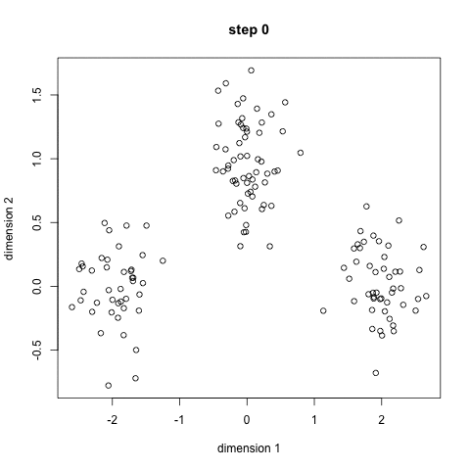
Clustering

Slide 74
Clustering
hierarchical clustering (also called hierarchical cluster analysis or HCA) is a method of cluster analysis which seeks to build ahierarchy of clusters. Strategies for hierarchical clustering generally fall into two types: ^{[1]}
Agglomerative: This is a "bottom up" approach: each observation starts in its own cluster, and pairs of clusters are merged as one moves up the hierarchy.
Divisive: This is a "top down" approach: all observations start in one cluster, and splits are performed recursively as one moves down the hierarchy.

Slide 75
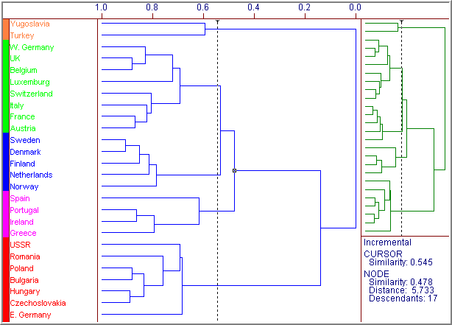
Clustering

Slide 76
Regression
regression analysis is a statistical process for estimating the relationships among variables. It includes many techniques for modeling and analysing several variables, when the focus is on the relationship between a dependent variable and one or more independent variables.
y = a + bx
y = a + bx + cy
ln ( p /1-p) = a + bx

Slide 77
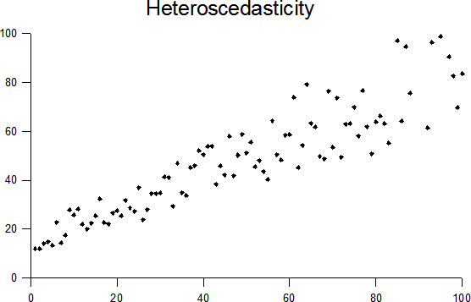
Regression
In statistics, multicollinearity (also collinearity) is a phenomenon in which two or more predictor variables in a multiple regression model are highly correlated, meaning that one can be linearly predicted from the others with a non-trivial degree of accuracy. A multiple regression model with correlated predictors can indicate how well the entire bundle of predictors predicts the outcome variable, but it may not give valid results about any individual predictor
heteroscedasticity(also spelled heteroskedasticity) refers to the circumstance in which the variability of a variable is unequal across the range of values of a second variable that predicts it.
The p-value for each term tests the null hypothesis that the coefficient is equal to zero (no effect). A low p-value (< 0.05) indicates that you can reject the null hypothesis.

Slide 78
Text Mining
Text mining, also referred to as text data mining, roughly equivalent to text analytics, refers to the process of deriving high-quality information from text.
Corpus - text corpus is a large and structured set of texts
A document-term matrix or term-document matrix is a mathematical matrix that describes the frequency of terms that occur in a collection of documents.
D1 = "I like databases"
D2 = "I hate databases",
then the document-term matrix would be:
 | I | like | hate | databases
D1 | 1 | 1 | 0 | 1
D2 | 1 | 0 | 1 | 1

Slide 79
Text Mining
http://www.rdatamining.com/examples/text-mining
Retrieving Text
Transforming Text to corpus
Cleaning Text (lowercase, punctuation, numbers, commonly used words (stop words))
Stemming Words
Building a Document-Term Matrix
Frequent Terms and Associations
Word Cloud

Slide 80
Sentiment Analysis
Sentiment analysis (also known as opinion mining) refers to the use of natural language processing, text analysis andcomputational linguistics to identify and extract subjective information in source materials.
Generally speaking, sentiment analysis aims to determine the attitude of a speaker or a writer with respect to some topic or the overall contextual polarity of a document
example- http://www.slideshare.net/ajayohri/twitter-analysis-by-kaify-rais

Slide 81
Sentiment Analysis
A sentiment analysis model is used to analyze a text string and classify it with one of the labels that you provide; for example, you could analyze a tweet to determine whether it is positive or negative, or analyze an email to determine whether it is happy, frustrated, or sad.
R package "sentiment"
Another interesting option that we can use to do our sentiment analysis is by utilizing the R package sentimentby Timothy Jurka. This package contains two handy functions serving our purposes:
classify_emotion
This function helps us to analyze some text and classify it in different types of emotion: anger, disgust, fear, joy, sadness, and surprise.
classify_polarity
In contrast to the classification of emotions, the classify_polarity function allows us to classify some text as positive or negative.
example- https://sites.google.com/site/miningtwitter/questions/sentiment/sentiment

Slide 82
Social Network Analysis
Social network analysis (SNA) is a strategy for investigating social structures through the use ofnetwork and graph theories. It characterizes networked structures in terms of nodes (individual actors, people, or things within the network) and the ties or edges (relationships or interactions) that connect them.
The NSA has been performing social network analysis on Call Detail Records (CDRs), also known as metadata, since shortly after the September 11 Attacks
Social Network Analysis to Optimize Tax Enforcement Effort -The South African Revenue Service
http://aisel.aisnet.org/cgi/viewcontent.cgi?article=1579&context=amcis2012
Irish Tax & Customs Authority
http://www.sas.com/en_ie/customers/irish-tax-and-customers.html

Slide 83
Social Network Analysis
Bridge: An individual whose weak ties fill a structural hole, providing the only link between two individuals or clusters. It also includes the shortest route when a longer one is unfeasible due to a high risk of message distortion or delivery failure.^{[18]}
Centrality: Centrality refers to a group of metrics that aim to quantify the "importance" or "influence" (in a variety of senses) of a particular node (or group) within a network.
Density: The proportion of direct ties in a network relative to the total number possible.^{[25][26]}
Distance: The minimum number of ties required to connect two particular actors, as popularized by Stanley Milgram’s small world experiment and the idea of ‘six degrees of separation’.
Mutuality/Reciprocity: The extent to which two actors reciprocate each other’s friendship or other interaction.^{[16]}
Network Closure: A measure of the completeness of relational triads.

Slide 84
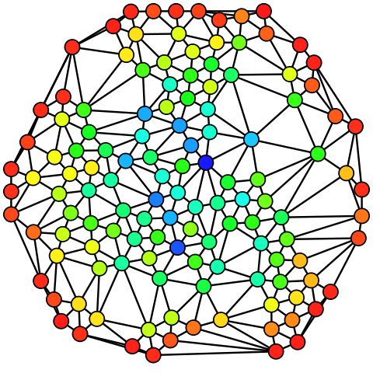
Social Network Analysis
Hue (from red=0 to blue=max) indicates each node's betweenness centrality.

Slide 85
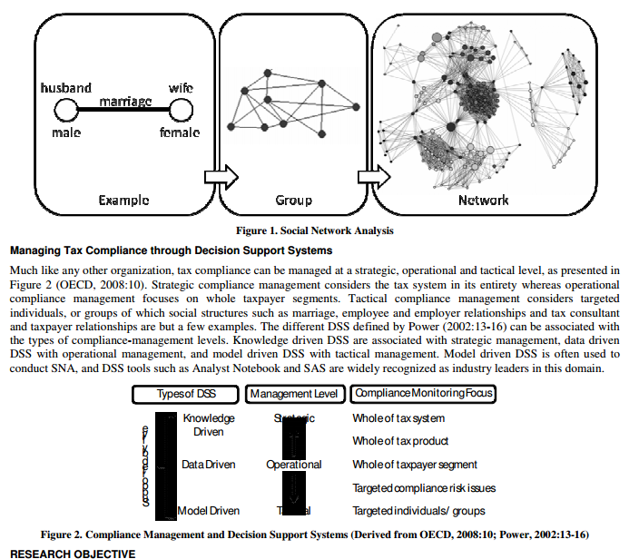
Social Network Analysis

Slide 86
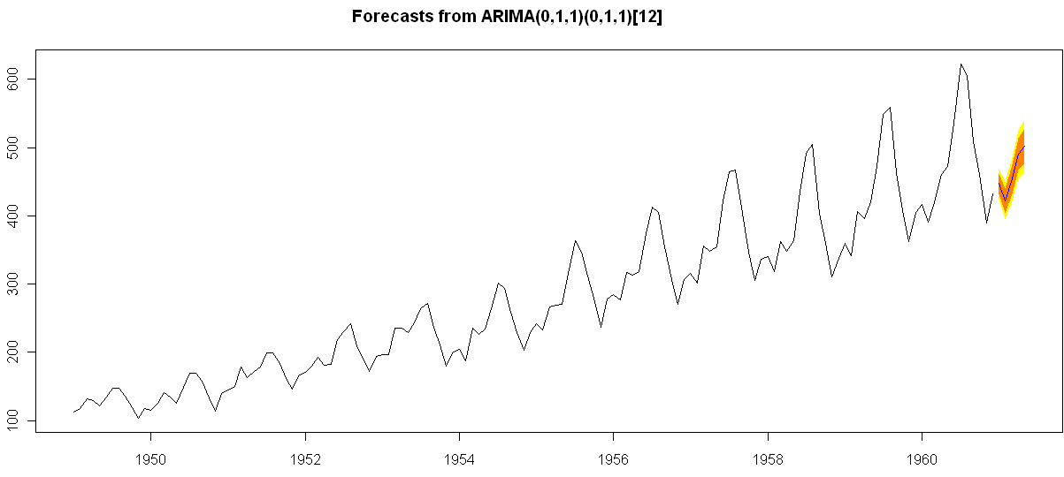
Time Series Forecasting
A time series is a sequence of data points, typically consisting of successive measurements made over a time interval. Time series analysis comprises methods for analyzing time series data in order to extract meaningful statistics and other characteristics of the data. Time series forecasting is the use of a model to predict future values based on previously observed values.

Slide 87
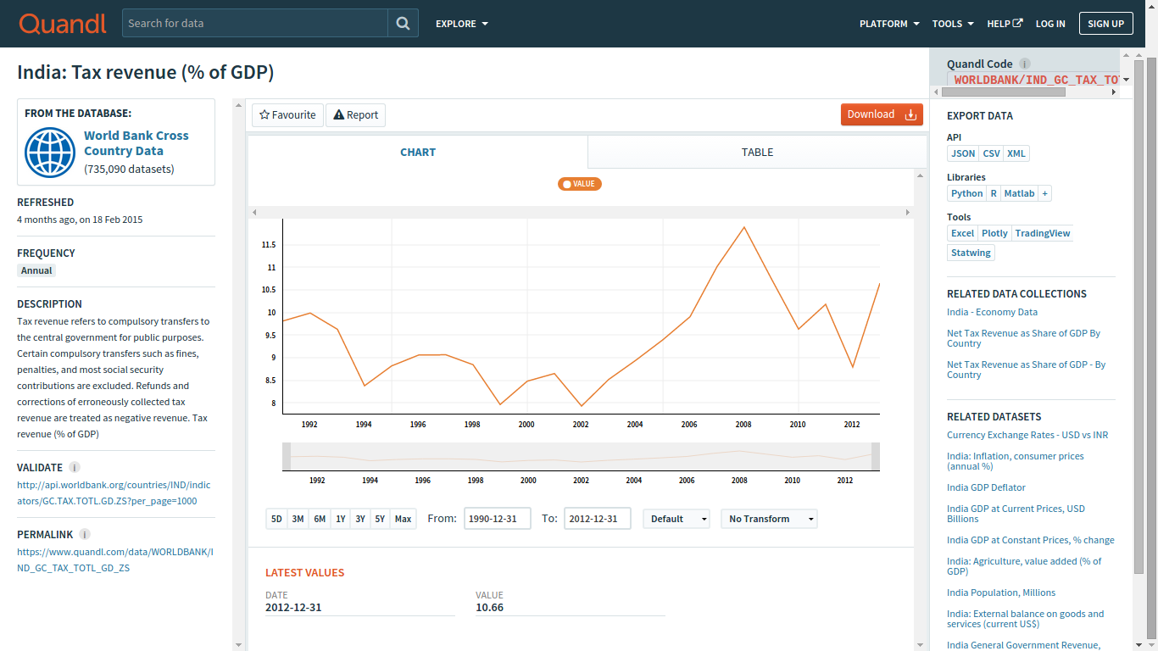
Web Data for Time Series
https://www.quandl.com/data/WORLDBANK/IND_GC_TAX_TOTL_GD_ZS-India-Tax-revenue-of-GDP

Slide 88
Introduction to Web Analytics

Slide 89
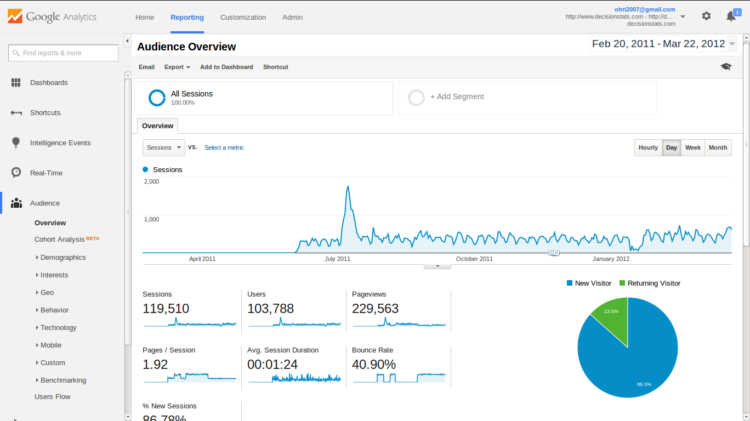
Introduction to Web Analytics

Slide 90
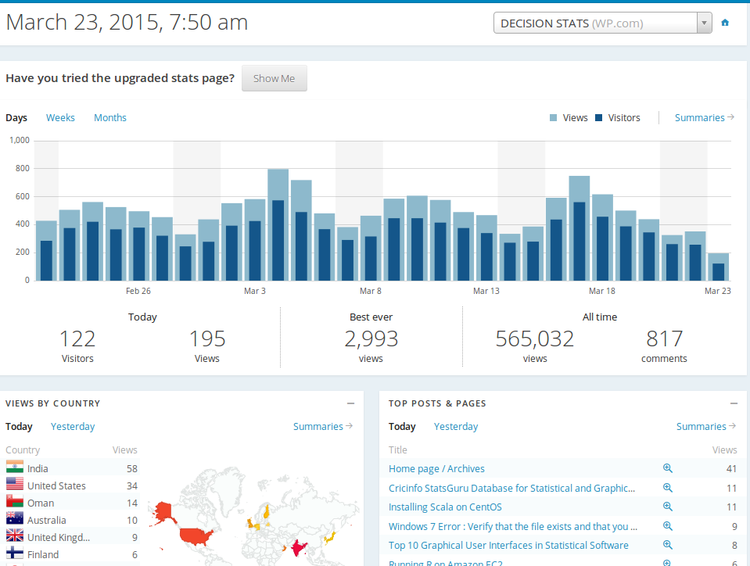
Introduction to Web Analytics

Slide 91
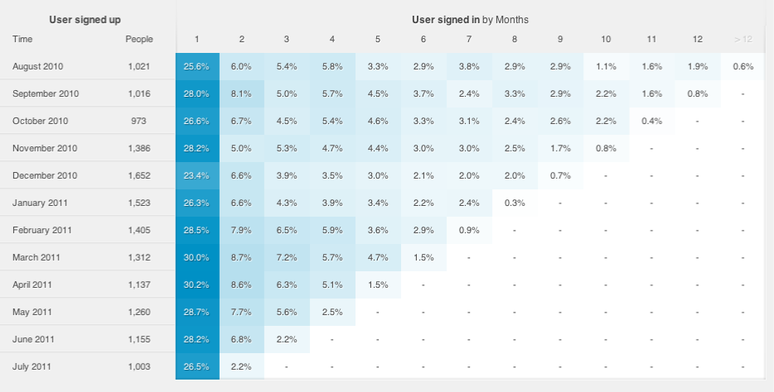
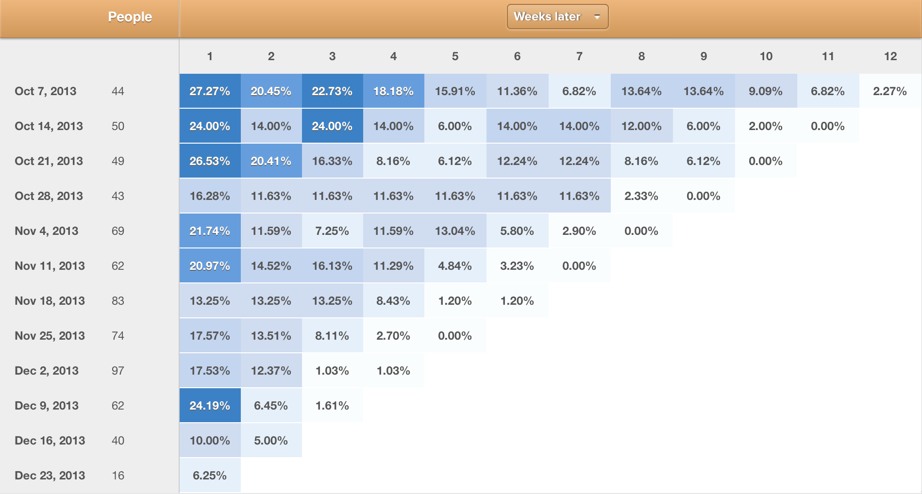
New: Cohort Analysis
Cohort analysis is a subset of behavioral analytics that takes the data from a given eCommerce platform, web application, or online game and rather than looking at all users as one unit, it breaks them into related groups for analysis. These related groups, or cohorts, usually share common characteristics or experiences within a defined timespan.

Slide 92
Introduction to Blogging

Slide 93
Why Blogging?
Because this is the age of bloggers
You can build your own identity and reputation globally at no cost
Improves your communication
Helps job chances
Even PM of India recommends social media

Slide 94
Blog
how - content ( topics, tags, categories)
navigation (themes, custom, widgets)
sharing (social, email , links)

Slide 95
Wordpress Basics
Admin Dashboard
Themes
Plugins
General

Slide 96
Blogging Basics
Content
Blog Post Title
Navigation
Theme
Sharing Content

Slide 97


Slide 98


Slide 99


Slide 100


Slide 101


Slide 102
Quiz Time
LTV
https://docs.google.com/forms/d/1lLbkLTZgZVrM7EovRibhCD10qN38Tk9xrwOcZ6WPYiY/viewform
RFM
https://docs.google.com/forms/d/1_LPANhgPURQi_8zi840TGs9ahS4G6VqexnNWRDCvq5w/viewform

Slide 103
Summer School

